Slide 1
Healthcare Analytics Project
Tools Used: Excel | Power BI | Tableau | MySQL
Presented By:
Arshin Akram

Slide 2
Agenda
Introduction & Objectives
KPIs
Dashboards: Excel, Power BI, Tableau
MySQL Queries
Conclusion
Inferences
Challenges & Solutions

Slide 3
Introduction & Objectives
Introduction:
Healthcare generates vast amounts of patient, treatment, and diagnostic data.
Analyzing this data helps improve patient care, optimize resource allocation, and support decision-making.
Objectives:
Build dashboards in Excel, Power BI, and Tableau to visualize healthcare data.
Generate insights from KPIs related to patients, doctors, treatments, and revenue.
Answer key business questions like workload, follow-ups, and diagnosis trends.

Slide 4
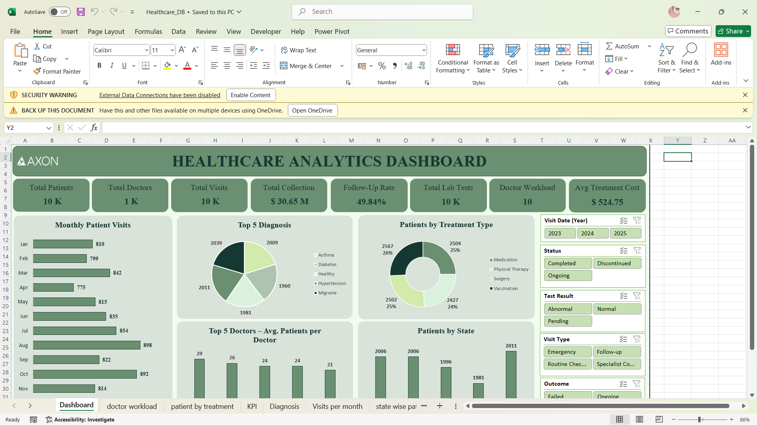
KPI 1 – Total Patients
The healthcare facility served 10,000 unique patients during the analysis period.
This indicates a high patient inflow, reflecting the hospital’s reach and trust in the community.
The number helps assess resource allocation, such as staffing, beds, and treatment availability.
Comparing with doctor count and visits, it provides insight into patient-to-doctor ratios and overall operational efficiency.

Slide 5
KPI 2 – Total Doctors
There are 1,000 doctors serving the hospital network.
This ensures a balanced workforce capable of handling the patient load efficiently.
It allows the hospital to maintain quality care standards, preventing overburdening staff.
When analyzed with patient and visit data, it provides insight into workload distribution and staffing requirements.

Slide 6
KPI 3 – Total Visits
The hospital recorded 10,000 total visits across all patients.
This metric reflects patient engagement and the frequency of service utilization.
A higher number may indicate repeat visits or chronic cases, while lower may suggest underutilization.
Tracking visits over time helps in staff scheduling, resource planning, and understanding patient behavior trends.

Slide 7
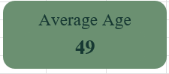
KPI 4 – Average Age of Patients
The average patient age gives insights into the demographic profile of the hospital’s clientele.
Helps identify age-specific treatment needs and preventive care programs.
Younger or older patient concentration may influence facility planning, equipment needs, and specialized services.
Age distribution also informs healthcare outreach and awareness campaigns for targeted population groups.

Slide 8
KPI 5 – Top 5 Diagnosed Conditions
Identifying the most common health conditions allows the hospital to focus on high-demand treatments.
Chronic diseases like diabetes or hypertension may dominate, showing long-term care requirements.
Helps in planning staff specialization, medicine stocking, and preventive programs.
Enables strategic decisions for patient education, wellness initiatives, and resource allocation to improve outcomes.

Slide 9
KPI 6 – Follow-up Rate
Follow-up rate measures the percentage of patients requiring additional visits after initial treatment.
A higher rate indicates ongoing care needs or chronic condition management.
It reflects treatment effectiveness, patient monitoring, and continuity of care.
Monitoring this KPI helps the hospital identify areas needing better interventions and improve overall healthcare quality.

Slide 10
KPI 7 – Treatment Cost per Visit (Average)
The average cost per patient visit provides insight into treatment affordability and financial efficiency.
Helps management understand resource consumption per patient, including tests, medications, and consultations.
Comparing costs across treatment types identifies high-cost areas and potential optimization.
This KPI is critical for budget planning, patient billing strategies, and cost-control initiatives.

Slide 11
KPI 8 – Total Lab Tests Conducted
Shows the total number of diagnostic tests performed during the analysis period.
Helps plan lab staffing, equipment maintenance, and scheduling.
Provides insight into patient care intensity and can indicate disease prevalence patterns based on test types.

Slide 12
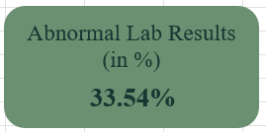
KPI 9 – Percentage of Abnormal Lab Results
Measures the proportion of lab tests showing abnormal results, indicating potential health risks.
High percentages highlight areas where preventive or corrective interventions may be needed.
Supports clinical decision-making for patient follow-ups and treatment prioritization.
Helps the hospital monitor community health trends and allocate resources efficiently.

Slide 13
KPI 10 – Doctor Workload (Avg Patients per Doctor)
Average number of patients handled by each doctor shows workload distribution.
Balanced workloads ensure quality care and prevent burnout among staff.
Identifies overburdened or underutilized doctors, helping in reallocation or hiring decisions.
Supports strategic planning for staffing, department efficiency, and patient satisfaction.

Slide 14
KPI 11 – Total Collection
Total collection combines treatment cost and visit charges, reflecting the hospital’s financial performance.
Helps management assess profitability and operational sustainability.
Enables budgeting and planning for new investments, equipment, or staff.
When compared with patient volume and costs, it provides insights into revenue per patient and service efficiency.

Slide 15
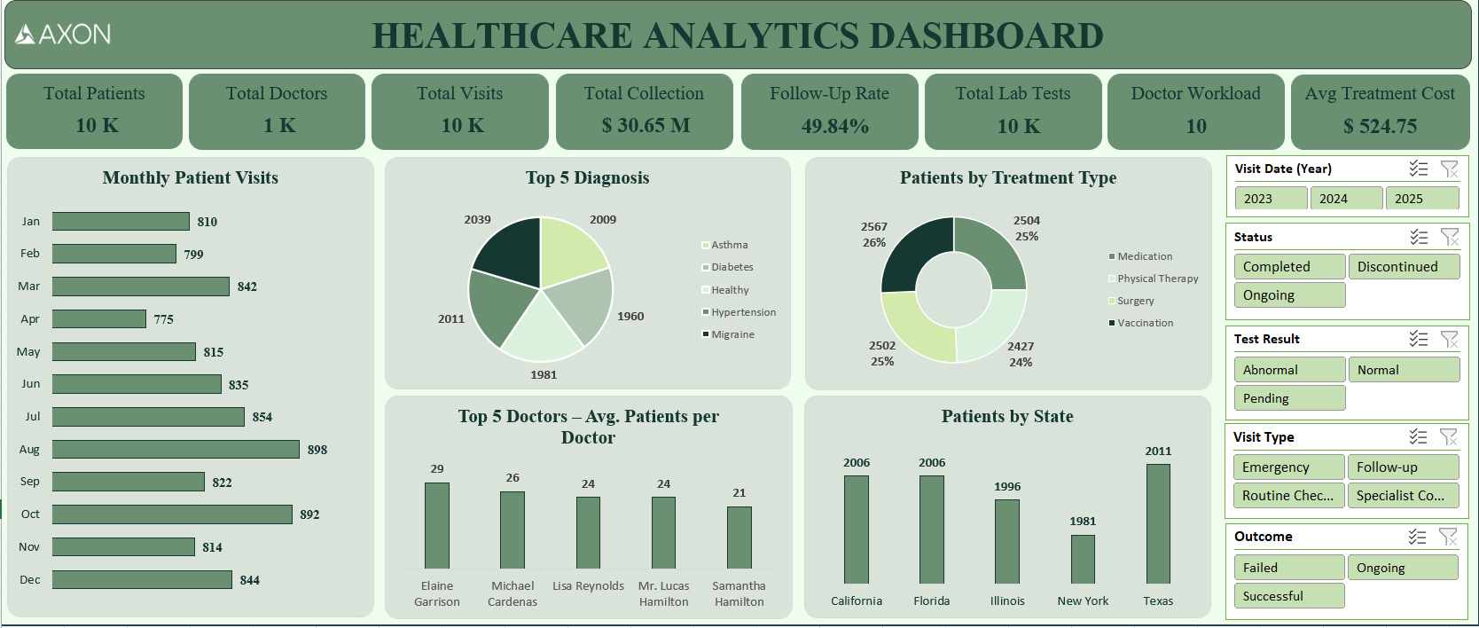
Dashboard – Excel

Slide 16
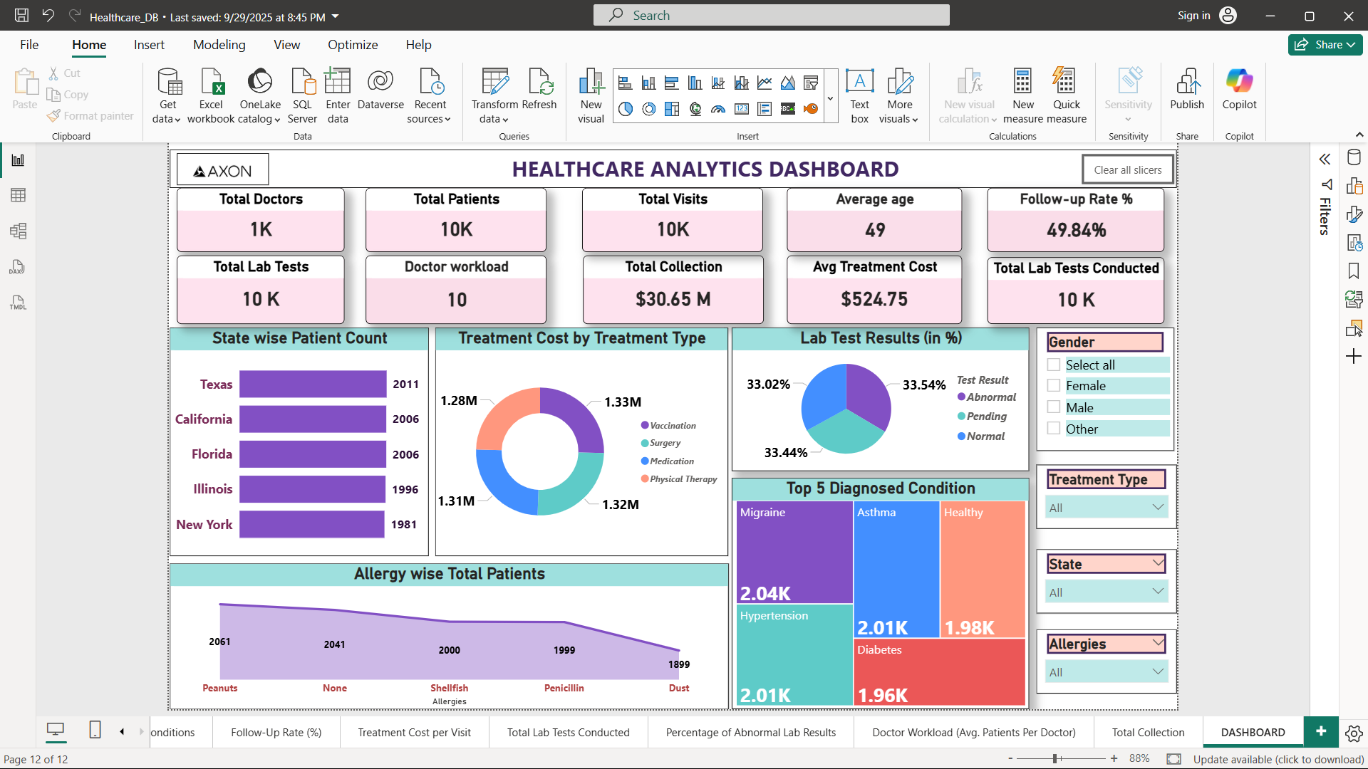
Dashboard – Power BI

Slide 17
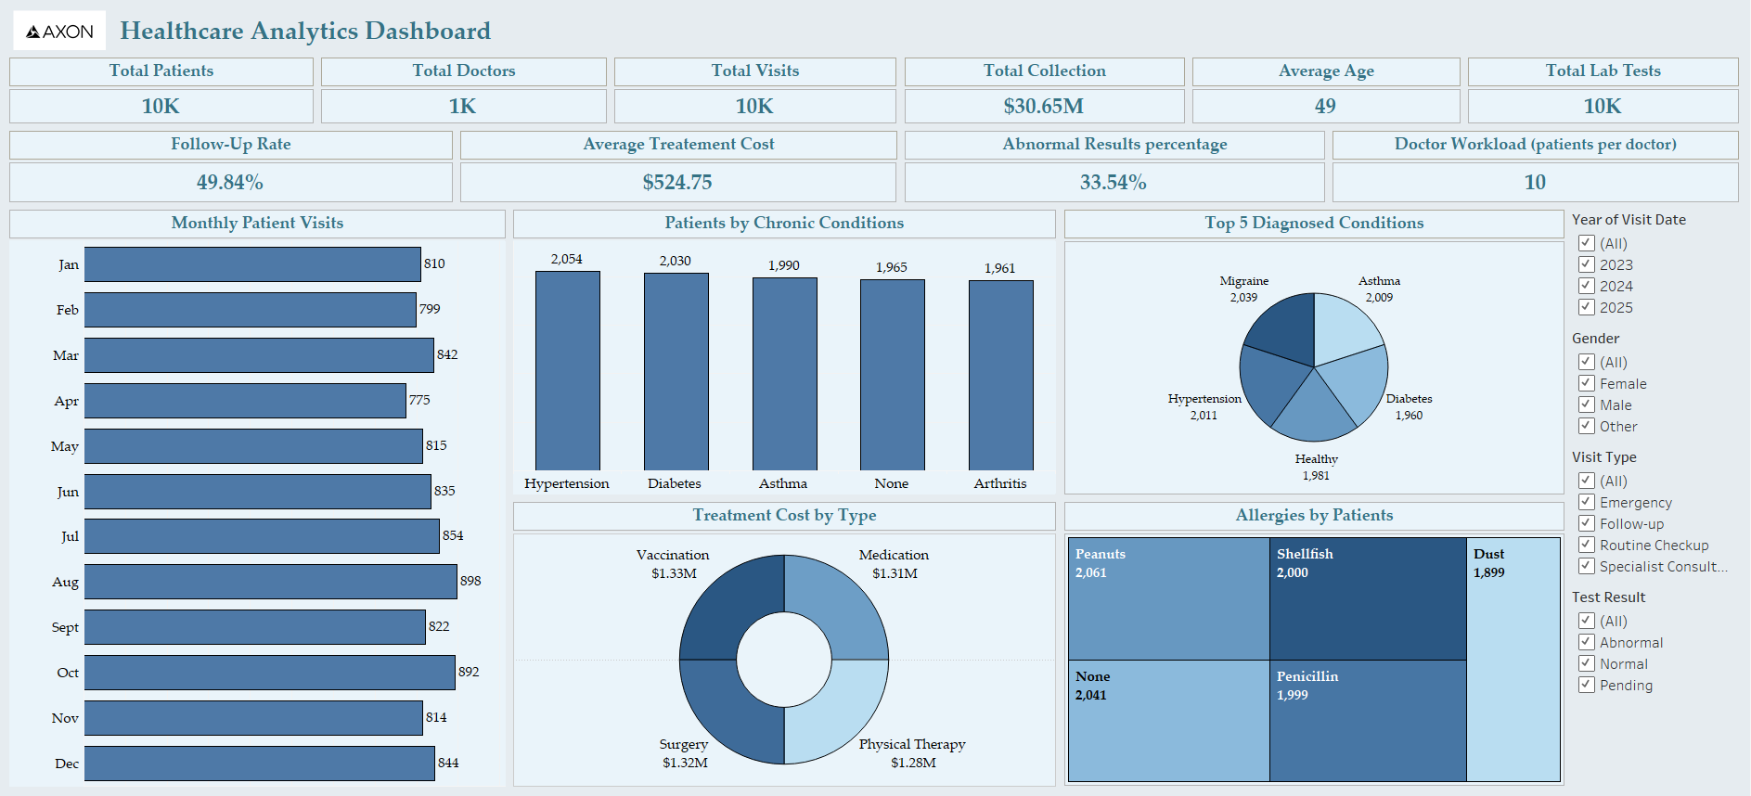
Dashboard – Tableau

Slide 18
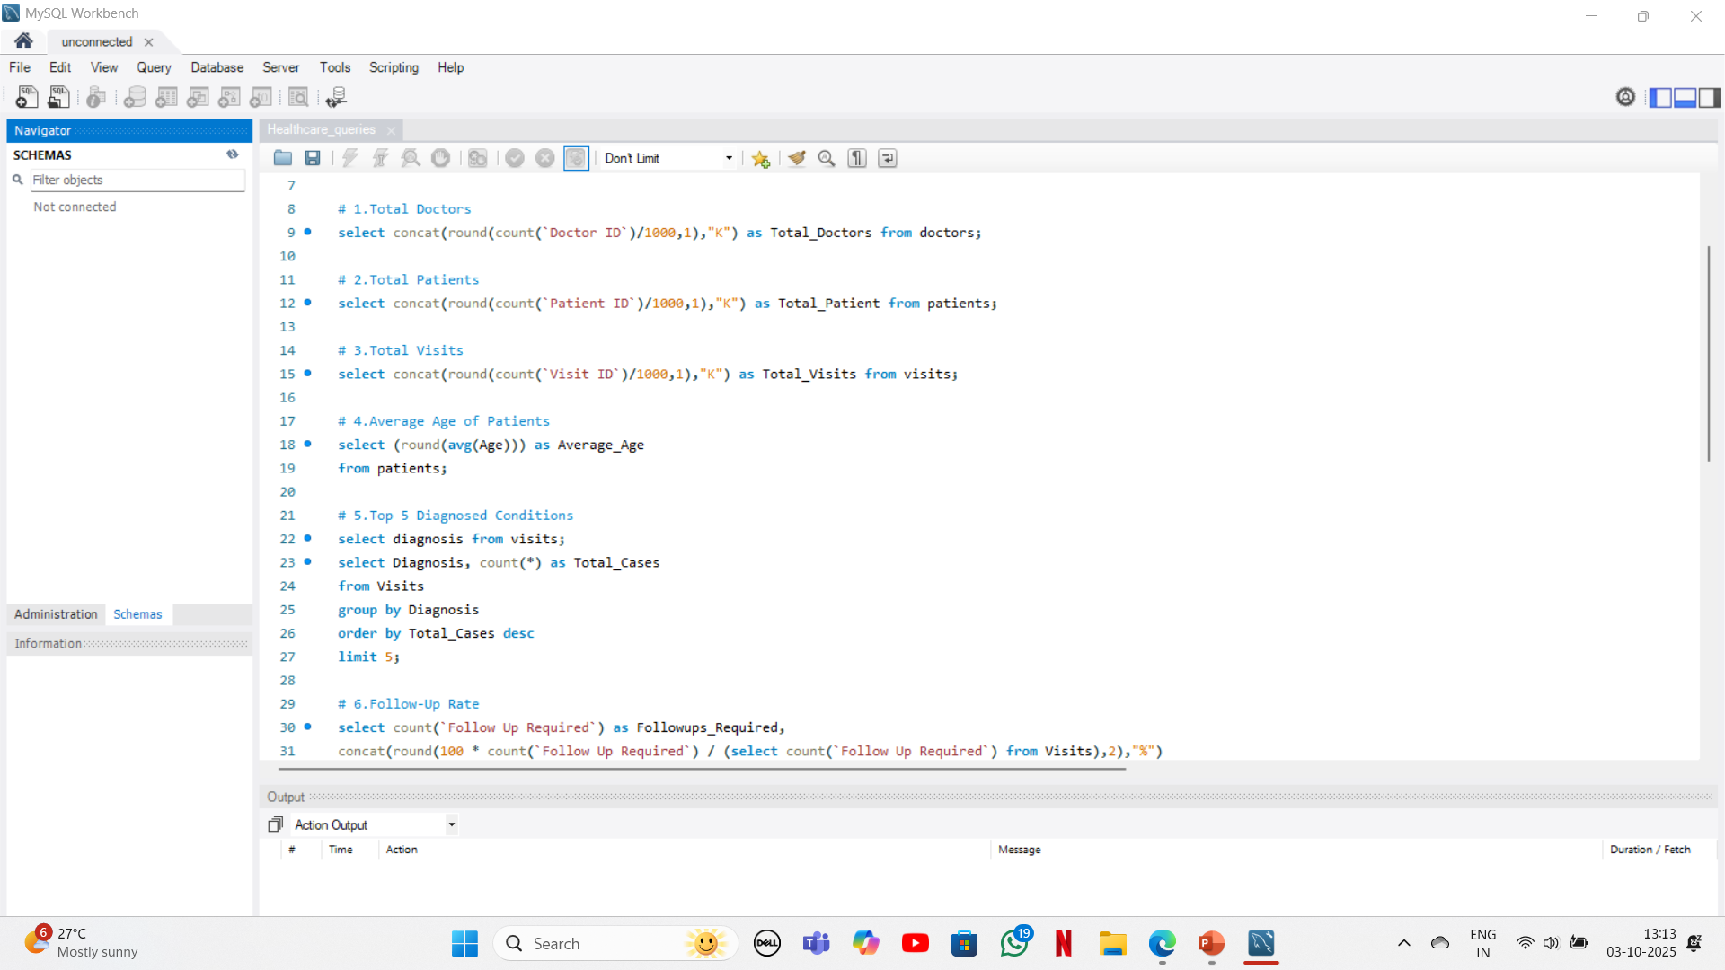
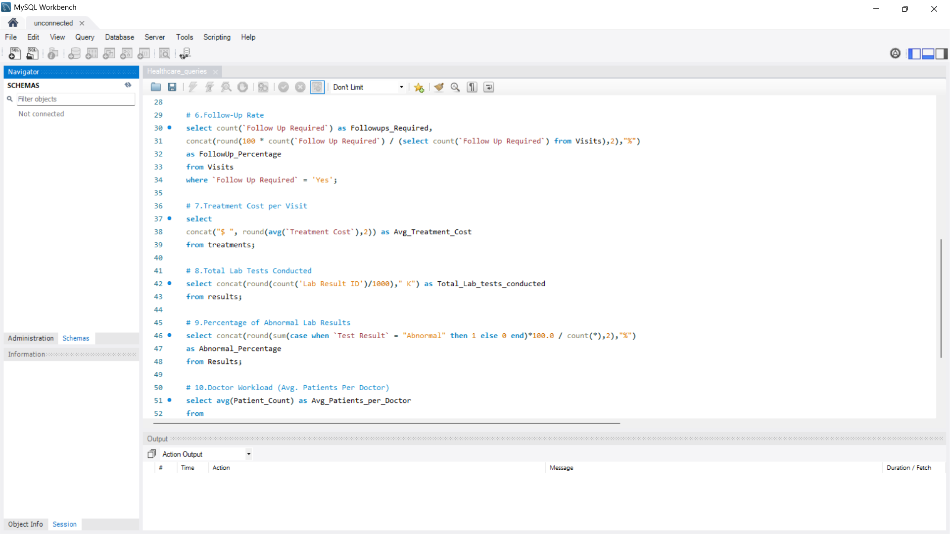
MySQL Queries

Slide 19
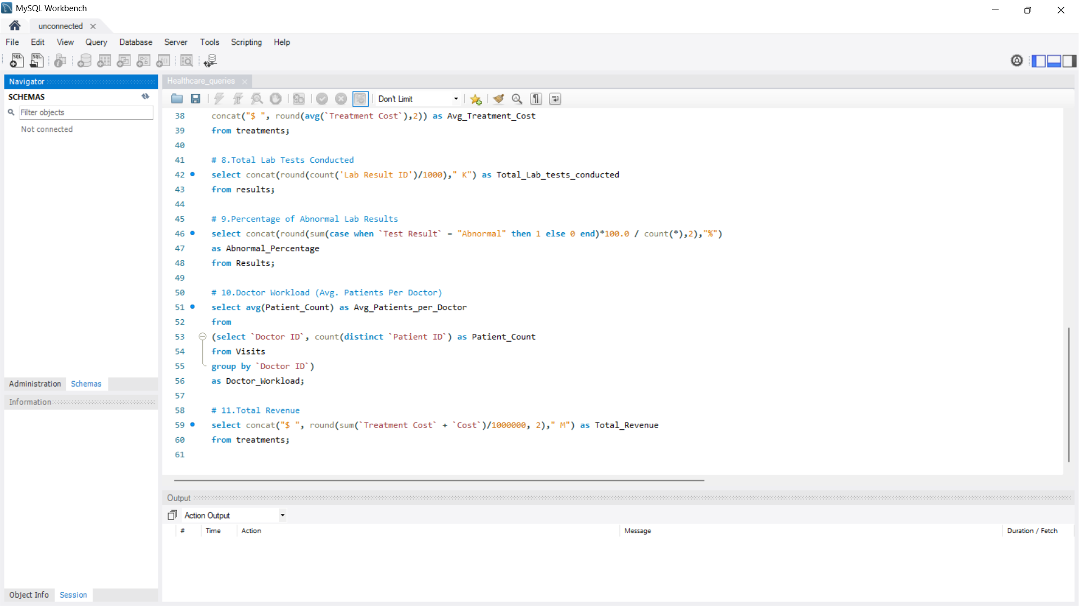
MySQL Queries

Slide 20
Conclusion
The analysis provided comprehensive insights into hospital operations, patient demographics, and financial performance.
Hospital served 10,000 patients with 1,000 doctors, maintaining a balanced patient-to-doctor ratio and manageable workloads.
Follow-up rates, top diagnosed conditions, and lab results highlighted areas for ongoing care, preventive programs, and resource planning.
Treatment costs, revenue, and average cost per visit helped evaluate financial efficiency and guide budgeting decisions.
Dashboards in Excel, Power BI, and Tableau enabled interactive visualization of key KPIs.
Demonstrates how data-driven healthcare analytics supports decision-making, resource optimization, and improved patient outcomes.

Slide 21
Inferences
The analysis provides a holistic view of hospital operations, highlighting patient demographics, doctor workload, and treatment trends.
Key KPIs such as Top Diagnosed Conditions, Follow-up Rate, and Lab Results reveal areas needing focused care and preventive interventions.
Dashboards across Excel, Power BI, and Tableau enable interactive insights, supporting data-driven decision-making and optimized resource allocation.

Slide 22
Challenges Faced & Solution
Data Integration
Challenge: Multiple tables (Doctors, Patients, Visits, Treatments, Lab Results) needed to be connected.
Solution: Used Tableau relationships for seamless integration.
Data Import Issues
Challenge: Doctors CSV file was semicolon-delimited, causing errors during SQL import.
Solution: Converted semicolons to commas for successful upload.
Formula Errors in Calculated Fields
Challenge: In Tableau and Power BI, errors occurred when creating calculated measures.
Solution: Debugged step by step and verified field types.

Slide 23
Thank You!

